Slide 1
Unit 2 population & migration
APHUG 2018-2019

Slide 2
Population density
Population density measures the average number of people in an area
It is expressed in the number of people per square mile or square kilometer
Demographers study three types of population density:
Arithmetic density
Physiological density
Agricultural density

Slide 3
Arithmetic density
Calculated by dividing a region’s population by its total area
Let’s calculate!
In 2015, the U.S. had a population of 321,368,864 in a total area of 3,841,999 square miles
What was the United State’s arithmetic population density in 2015?
Arithmetic density says little about a population’s distribution
It does not say where in the area people live

Slide 4
Physiological density
Calculated by dividing population by the amount of arable land (land suitable for growing crops)
Let’s calculate!
Egypt’s population is 97,041,072 in a land area of 390,100 square miles. Egypt’s arable land is 2.8%
What is Egypt’s physiological density?
Egypt’s arithmetic density is much lower than its physiological density – only 226 people per square mile
A large difference between arithmetic & physiological densities indicates that a small percentage of land is capable of growing crops
Countries with large physiological densities face extra challenges feeding their populations

Slide 5
assessment
Learning Target:
Use population density to explain the relationship between people and the environment.

Slide 6
quiz
Physiological density is viewed as a superior measure of population density for which of the following reasons?
It is more reflective of population pressure on arable land
It yields the average population density
It is more reflective of the world’s largest population concentrations
It measures the average by dividing total land area by total number of people
It best reflects the percentage of a country’s population that is urbanized

Slide 7
Agricultural density
Compares the number of farmers to the area of arable land
Developed countries (i.e. U.S., Canada, United Kingdom, Germany, Japan, Italy, France) have lower agricultural densities because farmers have the resources to use technology to produce large quantities of food with few workers
Netherlands (developed country) | Bangladesh (developing country)
Arithmetic density: 1,044/sq. mile Physiological density: 3,505/sq. mile Agricultural density: 31/sq. mile | Arithmetic density: 2,914/sq. mile Physiological density: 4,938/sq. mile Agricultural density: 431/sq. mile

Slide 8
Population distribution & densities
Discussion Group:
Explain the implications of population distribution and density on a regional scale (within the United States)
Explain the implications of population distribution and density on a global scale
Economic | Social | Political | Environmental
Economic | Social | Political | Environmental

Slide 9
Population composition
Identifying the composition (make up) of a region’s population is crucial to understanding that region’s past, present, and future
Population composition involves the following demographic characteristics:
Language
Religion
Ethnicity
Age and Sex

Slide 10
Age and Sex
Regions have distribution patterns related to age and sex
Example: In 2013, Utah had the youngest average age in the U.S. at 29.9, while the oldest average age was in Maine at 43.5.
This difference is so significant that it shapes public policy
Officials in Utah have a higher percentage of school-aged children to provide services for
Official in Maine might be more concerned with services needed for the elderly
*similar distinctive patterns & the resulting issues also exist at the scale of cities and communities

Slide 11
Age and Sex
Differences in the gender balance can result from:
Wars
Migrations
Government policies
-Looking at entire communities, mining towns & military training bases often have significantly more males than females
-Within a city, the gender imbalance might appear if a neighborhood has a post-secondary institution offering courses that tend to attract mostly students of one gender

Slide 12
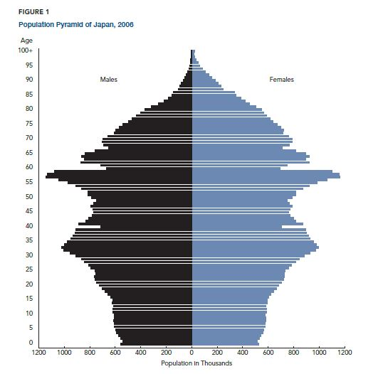
Population pyramids
Japan, 2006
Example of a country whose age-sex composition has been altered by past events
Low proportion of males above age 80 represents loss of young men during WWII
Small size of population 67-68 is the demographic response to the Sino-Japanese Incident in 1938
Large group ages 55-59 was born during the 1st “baby boom” period (1947-1951)

Slide 13
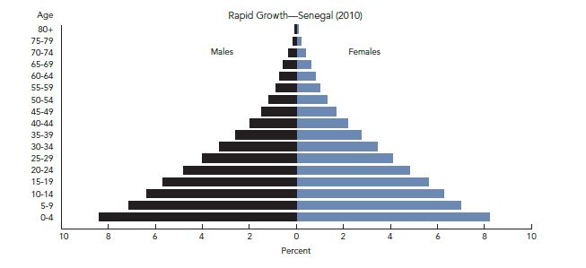
Population pyramids: 3 general profiles
Rapid Growth
Indicated by a pyramid with a large percentage of people in the younger ages
Shape is the result of high birth rates
Large proportions of young people almost guarantee that population will continue to grow during periods of declining fertility and for some time after fertility drops to replacement level (2.1 children per woman)

Slide 14
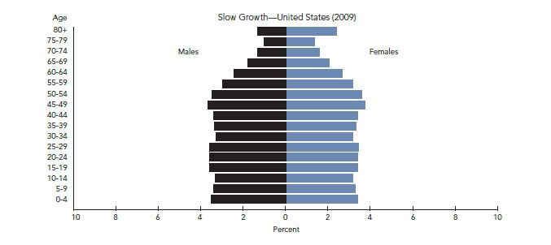
Population pyramids: 3 general profiles
Slow Growth
Reflected in a pyramid with a smaller proportion of the population in the younger ages
This age structure indicates that a population is still growing, but at a much slower rate

Slide 15
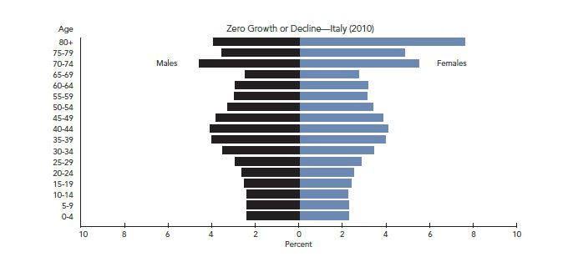
Population pyramids: 3 general profiles
Zero Growth or Decline
Reflected by decreasing numbers in the younger age groups
Typical of low-fertility populations experiencing zero growth and facing population decline

Slide 16
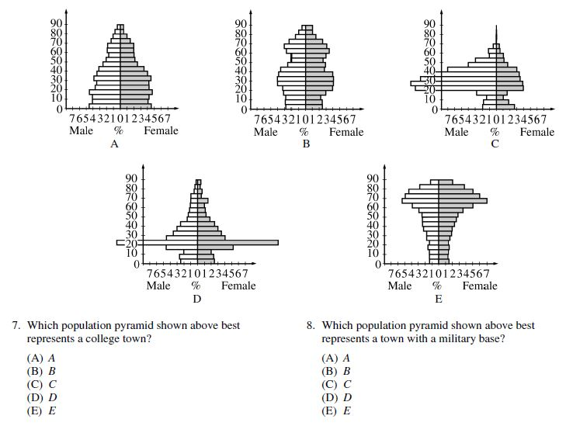

Slide 17
Demographic transition model
Learning Target:
I can use the demographic transition model to explain population change over time and space.

Slide 18
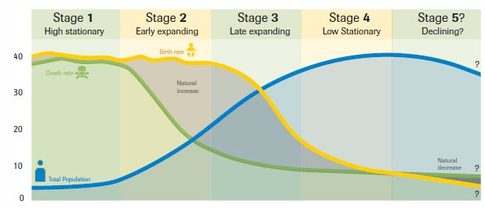
Demographic transition model
The Demographic Transition Model shows five typical stages of population change that countries pass through as they modernize (shift from agrarian to an industrial society)

Slide 19
Stage 1
 | Stage 1: High Stationary
Birth Rate | High, but fluctuating as need for farm labor changes
Death Rate | High, but fluctuating to reflect diseases and poor sanitation
Population Change | Very low growth because births and deaths are both high
Examples Today | Scattered isolated groups; no entire country in this stage
Population Composition | Very young

Slide 20
Stage 2
 | Stage 2: Early Expanding
Birth Rate | High, but fluctuating to reflect desires for big families
Death Rate | Rapidly declining as nutrition, sanitation, and medicine improve
Population Change | Rapid growth as death rates fall faster than birth rates
Examples Today | Mali South Sudan
Population Composition | Very young

Slide 21
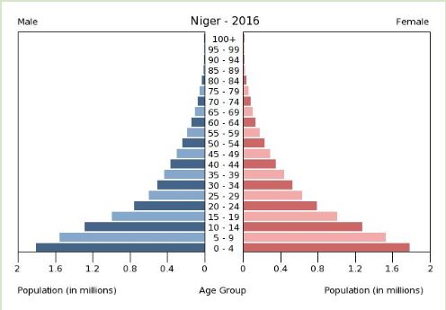
Stage 2 population pyramid
Niger (pronounced Nee-ZHER)represents a country with an expansive population pyramid
High birth rate produces a wide base
Low life expectancy leads to narrowing in the upper years
Typical of less developed regions

Slide 22
Stage 3
 | Stage 3: Late Expanding
Birth Rate | Declining as urbanization decreases the need for child labor
Death Rate | Declining, but not as fast as in previous stage
Population Change | Rapid but slowing growth as birth rates decline
Examples Today | Mexico Turkey
Population Composition | Young, with rising life expectancy

Slide 23
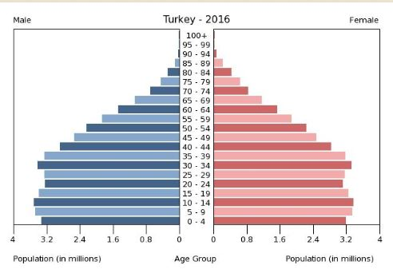
Stage 3 population pyramid
Turkey represents an urbanizing Stage 3 country
Declining birth rate
More slowly declining death rate
Society is still young, but the percentage of elderly is increasing as life expectancy goes up

Slide 24
Stage 4
 | Stage 4: Low Stationary
Birth Rate | Low, but not enough to keep the population stable
Death Rate | Low and stable
Population Change | Very low growth because births and deaths are both low
Examples Today | United States China
Population Composition | Balanced, with more aging

Slide 25
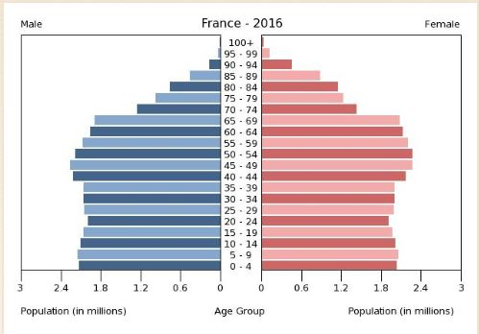
Stage 4 population pyramid
France’s pyramid represents a Stage 4 country – typical shape called stationary population pyramid
Population is not significantly growing or declining
Birth rate is low but steady
Death rate is low indicating high life expectancy & increased % of elderly
Typical of more developed countries

Slide 26
Stage 5
 | Stage 5: Declining
Birth Rate | So low it falls below the death rate
Death Rate | Low, sometimes increasing as the population ages
Population Change | Very low decline as births fall below deaths
Examples Today | Japan Germany
Population Composition | Very old

Slide 27
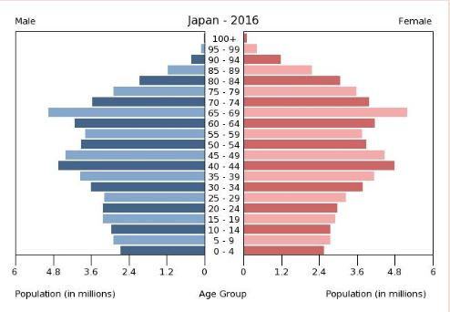
Stage 5 population pyramid
Japan’s pyramid represents a Stage 5 country
Narrow base reflects a decreasing birth rate
Population is aging
Population declining overall
Largest age group is 65-69

Slide 28
Discussion groups
Get in your discussion groups and take your role names out of your binder (questioner, facilitator, summarizer, time manager). Answer these questions on 1 sheet of paper.
1. What are the implications of countries in Stages 2 and 3 of the DTM? (think ESPen!)
2. What are the implications of countries in Stages 4 and 5 of the DTM? (think ESPen!)

